Slide 1
Microhttp server
Acceptance test

Slide 2
About the test
This document should describe the validation/acceptance procedure for the microhttp project
Tools used for the procedure:
Putty

Slide 3
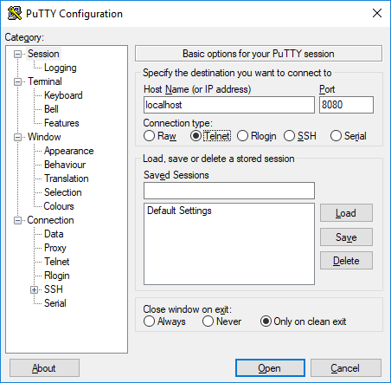
Setup
Run executables with no arguments
Setup putty with Telnet localhost 8080 settings

Slide 4
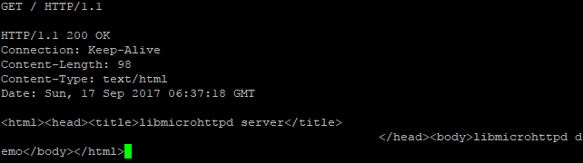
Test 1 – base page
Input following in putty and check answer

Slide 5
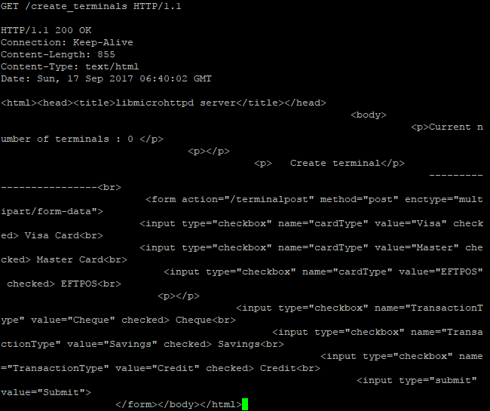
Test 2 – create terminals page
GET /create_terminals HTTP/1.1

Slide 6
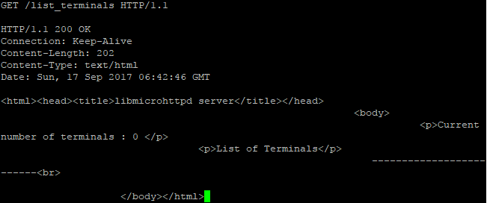
Test 3 – list terminals page
GET /list_terminals HTTP/1.1

Slide 7
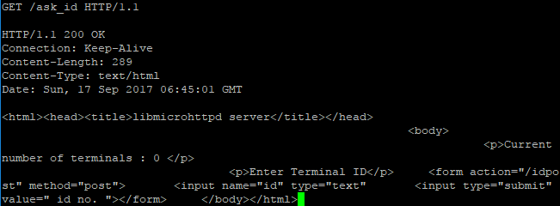
Test 4 – ask ID page
GET /ask_id HTTP/1.1

